Slide 1






GLADEWATER HIGH SCHOOL
DUAL CREDIT PROGRAM
2024-2025
REGISTRATION MAY 21st, 2024

Slide 2




DUAL CREDIT AT GHS
  PARTNERED WITH KILGORE COLLEGE
  GHS STUDENTS WILL BE COMBINED WITH STUDENTS FROM BIG SANDY, WHITE OAK & UNION GROVE
  WHITE OAK HIGH SCHOOL IS THE HOST CAMPUS

Slide 3




WHAT IS DUAL CREDIT?
  ALLOWS ELIGIBLE STUDENTS TO TAKE AND EARN CREDIT FOR COLLEGE AND HIGH SCHOOL COURSES AT THE SAME TIME.
  COLLEGE LEVEL CLASSES THAT FOLLOW KILGORE COLLEGE GRADING POLICIES, PROCEDURES, AND TIMELINES.
  VIEW DUAL CREDIT GRADES ANYTIME THROUGH THE STUDENT’S KILGORE COLLEGE BLACKBOARD ACCOUNT (NOT ASCENDER)

Slide 4

WHY SHOULD YOU TAKE DUAL CREDIT?

Slide 5



REASON 1
REASON 2
DEVELOP SKILLS NECESSARY FOR SUCCESS IN COLLEGE OR CAREER (MAKE THE TRANSITION FROM HOME TO COLLEGE EASIER)
SAVE TIME AND MONEY BY EARNING COLLEGE CREDITS while in high school

Slide 6
TO SUCCEED IN DUAL CREDIT COLLEGE COURSES, STUDENTS SHOULD HAVE:

Slide 7

1
2
3
GOOD STUDY SKILLS, SELF-DISCIPLINE, AND MOTIVATION
MATURITY AND INITIATIVE TO PARTICIPATE AT THE SAME LEVEL AS REGULAR COLLEGE STUDENTS
EXCELLENT ATTENDANCE

Slide 8
4
5
HELP YOUR STUDENT EVALUATE WHERE THEY FALL IN RELATION TO THESE CRITICAL CHARACTERISTICS FOR SUCCESS. SOME STUDENTS ARE NOT READY FOR THIS INCREASED RESPONSIBILITY AS JUNIORS AND DECIDE IT’S MORE APPROPRIATE TO WAIT UNTIL THEIR SENIOR YEAR. THAT’S PERFECTLY OK.
ABILITY TO JUGGLE EXTRA-CURRICULAR ACTIVITIES WITH INCREASED ACADEMIC DEMANDS

Slide 9

WHAT ARE THE TYPES OF DUAL CREDIT?
  ACADEMIC DUAL CREDIT
    (US HISTORY, SOCIOLOGY, MUSIC APPRECIATION, ETC.)
  WORKFORCE DUAL CREDIT
    (FIRE ACADEMY & PATIENT CARE TECH)

Slide 10

WHAT COURSES CAN I TAKE FOR ACADEMIC DUAL CREDIT?
11TH GRADERS:
12TH GRADERS:
  HISTORY 1301
  HISTORY 1302
  MUSIC 1306
  GOVERNMENT 2306
TOTAL – 12 HOURS
  English 1301
  English 1302
  Government 2305
  Psychology 2301
TOTAL – 12 HOURS
24 POSSIBLE HOURS
*COURSE OFFERINGS ARE SUBJECT TO CHANGE.

Slide 11
HOW DOES ACADEMIC DUAL CREDIT WORK?
ALL Students
  Students will be enrolled in two different courses each semester
  MONDAY & WEDNESDAY - attend one course (Ex: HIST 1301)
  TUESDAY & THURSDAY- attend opposite course
SPRING 2025
Courses will be different in the spring semester (January 2025)

Slide 12
HOW DO I DEMONSTRATE COLLEGE READINESS TO BE ELIGIBLE TO ENROLL IN DUAL CREDIT COURSES?

Slide 13
STAAR END-OF-COURSE (EOC):
TEXAS SUCCESS INITIATIVE ASSESSMENT 2 (TSIA2): 2
  English II EOC – 4000
  Algebra I EOC – 4000 with passing grade in Algebra II (or)
  English, 945 or greater with an essay score of 5 or greater. If less than 945, Diagnostic Test Score of 5 or greater and an Essay Score of 5 or greater.
  Math, 950 or greater. If less than 950, Diagnostic Score of 6. (only required for seniors taking dual credit statistics and College algebra)

Slide 14
ACT:
SAT:
  Prior to Feb 15, 2023: Composite score of 23 with 19 on English for Reading and Writing and/or 19 on Math. On or after Feb 15, 2023: Combined score of 40 on the English and Reading (E+R) tests shall be exempt for both reading and writing or ELAR sections of the TSI Assessment. A score of 22 on the mathematics test shall be exempt for the mathematics section of the TSI Assessment. There is no composite score. (or)
480 on Reading and Writing and/or a score of 530 on Math.

Slide 15

COLLEGE READINESS
  NEW DUAL CREDIT STUDENTS WILL NOT HAVE DUAL CREDIT COURSES ADDED TO THEIR GHS SCHEDULE UNTIL THEY DEMONSTRATE COLLEGE READINESS.
  NEW ACADEMIC DUAL CREDIT STUDENTS TAKE THE TSI ENGLISH ASSESSMENT IF THEY DO NOT MEET COLLEGE READINESS STANDARDS ON THE STAAR EOC ENGLISH II OR ACT.
  SENIORS WHO WOULD LIKE TO TAKE DUAL CREDIT MATH COURSES MUST TAKE THE TSI MATH ASSESSMENT (UNLESS YOU HAVE MET THE REQUIRED STAAR/ACT/SAT MATH SCORES– SEE CHART ON SLIDE 15 & 16)
  THE TSI TEST WILL BE OFFERED FREE OF CHARGE AT GLADEWATER HIGH SCHOOL (STUDENTS WHO DO NOT TAKE THE EXAM ON THE DESIGNATED DAY SHOULD MAKE AN APPOINTMENT/ PAY TO TAKE IT AT THE KILGORE COLLEGE TESTING CENTER 903-983-8215 OR WWW.KILGORE.EDU/TESTING-KILGORE )

Slide 16
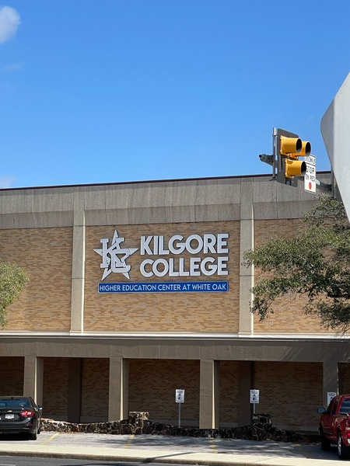
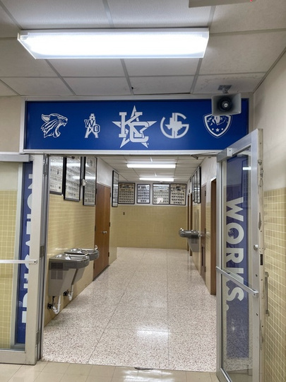

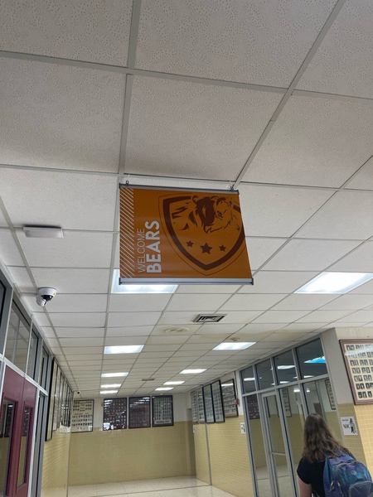
LOCATION?
White Oak High School
Room assignment is determined by student enrollment and will be assigned in the August 2024

Slide 17
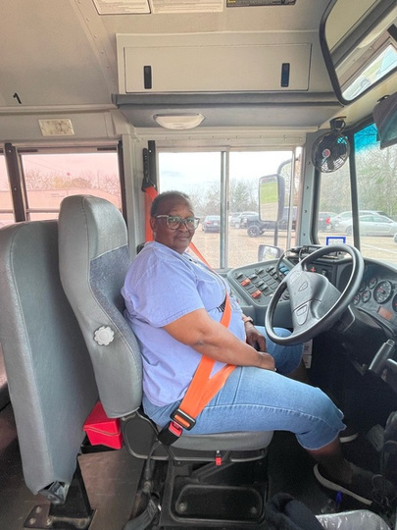
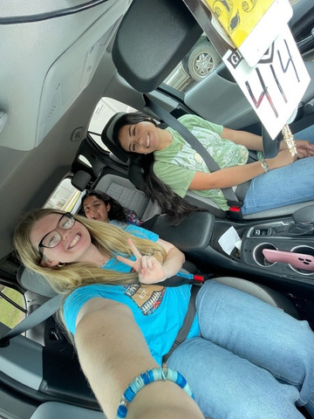
TRANSPORTATION?
With permission from parents:
  Personal Vehicles
  School provided transportation

Slide 18
DUAL CREDIT REGISTRATION STEPS

Slide 19
  ALL DUAL CREDIT STUDENTS (NEW & RETURNING) COMPLETE GHS ON-LINE DUAL CREDIT REGISTRATION LINK ON FINAL SLIDE (BY MAY 21ST)
  THIS PROCESS MUST BE COMPLETED WITH A PARENT. FOR RETURNING STUDENTS THIS PROCESS WILL TAKE ONLY A COUPLE OF MINUTES, BUT FOR NEW DUAL CREDIT STUDENTS, IT WILL TAKE 20-30 MINUTES. BE SURE TO KEEP CHECKING THE EMAIL YOU ENTER ON YOUR KILGORE COLLEGE DUAL CREDIT APPLICATION FOR YOUR WELCOME ACCEPTANCE AND A FOLLOW-UP EMAIL FROM KC THAT WILL CONTAIN YOUR NEW KC ID#.
  STUDENTS MAY RETAKE ANY SECTION OF THE TSI TEST AT THE KILGORE COLLEGE ASSESSMENT CENTER IF THEIR SCORE DOES NOT MEET THE MINIMUM PASSING STANDARD (SEE SLIDE 15). IN ORDER TO COMPLETE THE REGISTRATION FOR YOUR STUDENT WITH KILGORE COLLEGE, PASSING SCORE REPORTS FOR RETAKES SHOULD BE EMAILED BY THE STUDENT TO HESTERK@GLADEWATERISD.COM BY 6/23/24

Slide 20
  TEST SCORES/TRANSCRIPT SENT TO KILGORE COLLEGE (SENT BY GHS WITH KC COURSE REGISTRATION IN JUNE 2024)
  KILGORE COLLEGE POSTS FALL SEMESTER BILLS TO STUDENT’S ON-LINE KC ACCOUNT/THEY ARE NOT MAILED
  PURCHASE/RENT TEXTBOOKS (ON-LINE OR THROUGH THE KC BOOKSTORE) BY FIRST DAY OF DUAL CREDIT CLASSES (8/28/22)

Slide 21
SPECIAL EDUCATION/504 STUDENTS

Slide 22
  HOLLYANN DAVIS, KILGORE COLLEGE DISABILITY COORDINATOR, AT HADAVIS@KILGORE.EDU OR CALL (903) 983-8206 TO SET UP AN APPOINTMENT
  MRS. DAVIS MUST COMPLETE AN INTAKE AND DEVELOP/COORDINATE ACCOMMODATIONS WITH KILGORE COLLEGE INSTRUCTORS FOR ALL DUAL CREDIT CLASSES.
  CONTACT KILGORE COLLEGE DISABILITY SERVICES FOR ACCOMMODATIONS IN DUAL CREDIT COURSES.

Slide 23
I’M LOOKING FORWARD TO AN AWESOME YEAR IN DUAL CREDIT!
QUESTIONS – PLEASE CONTACT
KRISTYL HESTER, GISD DUAL CREDIT/CTE COORDINATOR
HESTERK@GLADEWATERISD.COM

Slide 24

REGISTRATION LINK
CLICK BELOW or SCAN QR CODE TO REGISTER FOR 2024-2025 DUAL CREDIT CLASSES AT GLADEWATER HIGH SCHOOL
LINK: DUAL CREDIT REGISTRATION

